Slide 1
Pandas and Jupyter Notebooks
Data Science in Python

Slide 2
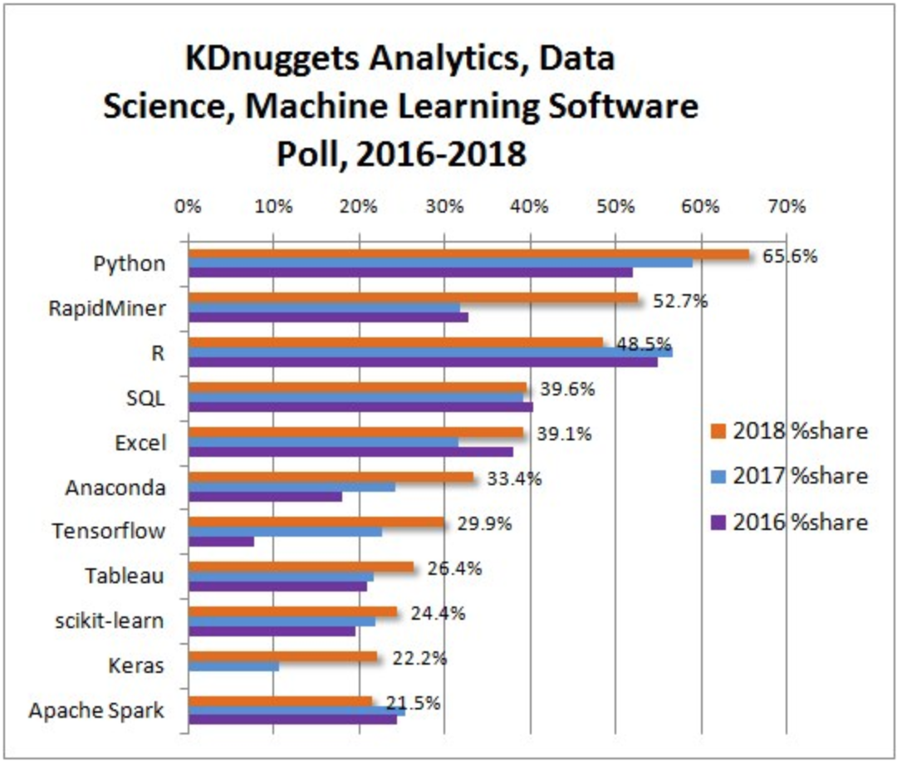
The 19th annual KDnuggets Software Poll
KDnuggets is a leading site on AI, Analytics, Big Data, Data Mining, Data Science, and Machine Learning (according to KDnuggets)
Participants on average chose ~7 tools
Python has grown over the last few years, while R seemed to decline from 2017 to 2018
What makes Python such a great tool for data science?

Slide 3
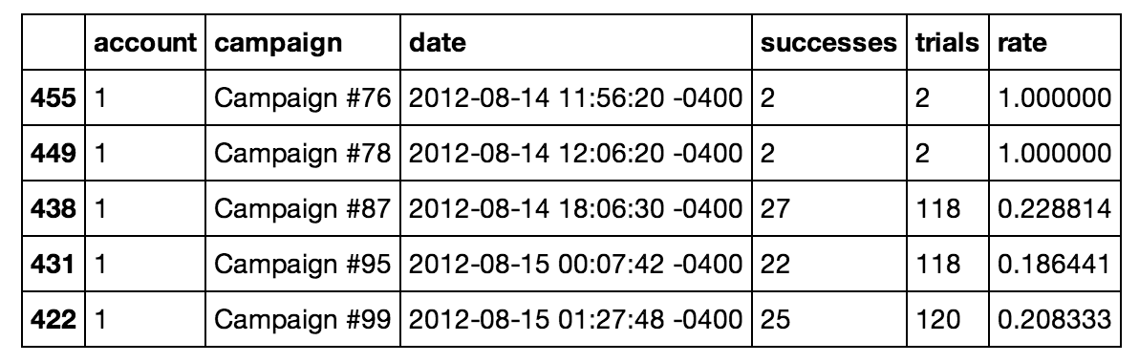
pandas
“pandas is an open source, BSD-licensed library providing high-performance, easy-to-use data structures and data analysis tools for the Python programming language.”
Functionality
Pandas DataFrame
Read and write data sets of common types: CSV, text files, Microsoft Excel, and SQL databases.
Merging and joining of datasets
Slicing, indexing and subsetting large sets of data
Groupby engine for aggregating and transforming data
Optimized for performance, critical code paths written in Cython or C

Slide 4
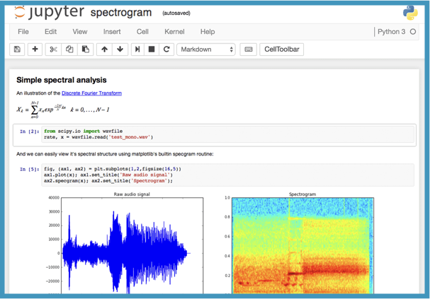
Jupyter Notebooks
Open source web application that allows you to create and share documents that contain code, equations, visualizations, and explainatory text.
REPL (A Read–Eval–Print Loop) is an interactive and efficient way to find errors in your code and get descriptive feedback fast in Python
Instantaneous feedback allows for high-speed development
Robust data visualization
Markdown
Code
Output

Slide 5
Live Demo

